Slide 1
Detective mystery game c# object-oriented programming project group-03 presented by: 1. mortuja bashir nill (2252081123) 2. Farzana Akter Eva (2252081127) 3. Rubaiya (2252081148) 4. MD.NAHIMUR RAHMAN ANTOR (2252081136)

Slide 2
How the Game Works?
1. Start Game
2. Select Case
3. Investigate Location
4. Find Clues
5. Earn Points
6. Collect Evidence
7. Examine Suspects
8. Identify Criminal
9. Final Result
Correct Suspect = WIN! Wrong Suspect = GAME OVER!

Slide 3
Class design detective class
Purpose: Represents the player who investigates the mystery.
Properties: Name, Points.
Methods:
○ AddPoints: Gives points and explains why the points were awarded.
○ DisplayInfo: Shows the detective's name and current points.
○ Investigate: Represents the detective investigating the mystery.

Slide 4
Suspect class
Purpose: Represents people who may be the criminal in the mystery.
Properties: Name, Occupation, IsCriminal.
Methods:
○ Examine Suspect: Investigates and examines a possible criminal.
○ DisplayInfo: Shows the suspect's name and occupation.

Slide 5
Clue class
Purpose: Represents clues found during the investigation.
Properties: Description, IsCorrect, Points.
Methods:
○ Display Clue: Shows the clue discovered during the investigation.

Slide 6
Evidence class
Purpose: Represents physical or important evidence collected during the investigation.
Properties: Name, Description.
Methods:
○ Display Evidence: Shows the name and description of collected evidence.

Slide 7
Location class
Purpose: Represents places where the detective searches for clues.
Properties: Name, Clues.
Methods:
○ Search Location: Investigates a location to find available clues.
○ Check Clues: Checks all clues found at the location and displays them.

Slide 8
Case class
Purpose: Represents the complete case being investigated.
Properties: CaseName, Crime, Locations, Suspects.
Methods:
○ Display Case: Shows the case name and crime details.

Slide 9
Mystery game class
Purpose: It manages the major activities of the detective game.
Properties: Detective, CurrentCase, EvidenceList.
Methods:
○ Case Selection: Selects the mystery case for investigation.
○ Investigation: Searches locations, finds clues, and examines suspects.
○ Evidence Management: Collects and displays the evidence found during the investigation.
○ Criminal Identification: Checks the final suspect and determines WIN or GAME OVER.

Slide 10
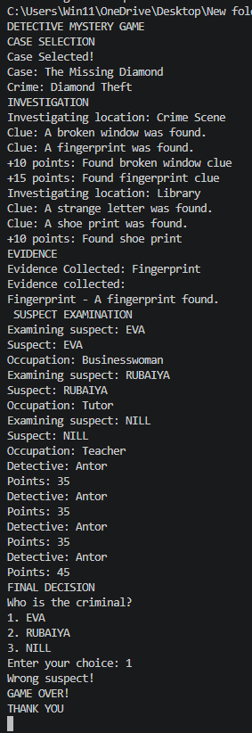
Output:

Slide 11
Thank you

